Slide 1

trailer ZONE

Slide 2
We’ve all been there
Trailers shape our opinion on an upcoming movies.
They attract millions of people to see the theaters.
In 2014, Hollywood studios collectively spent $3.16 billion marketing efforts to draw people to the theaters. _ Los Angeles Times
Was it always this way?

Slide 3
Movie trailers through history.
2017 –
1913 – beginning of trailers
Trailers were played at the end of each movie. (which explains its name)
Previews are shown before the film begins.
1990’s-
Movie trailers and TV spots became a part of the movie watching experience
The trailer voice over guy .
IN A WORLD.... IN A TIME.... THIS SUMMER...
Trailers are as important as the movie itself. People now performing breakdowns and live reactions on youtube.
trailer ZONE offers a revolutionary way to watch trailers.

Slide 4
trailer ZONE
It’s a functional app specially designed to meet your needs.
Now, you can scroll through the latest movies faster !
Search and watch trailers anywhere you want.
Find movie theaters near you in one click.

Slide 5
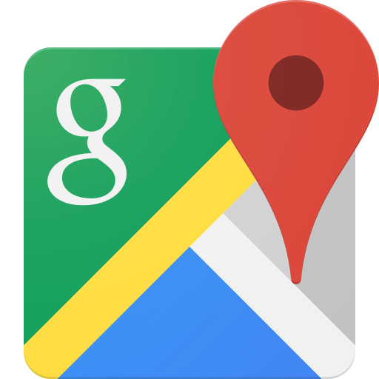


trailer ZONE
Made use of the following API’s
moviedb.org
foursquare.com
googlemaps

Slide 6
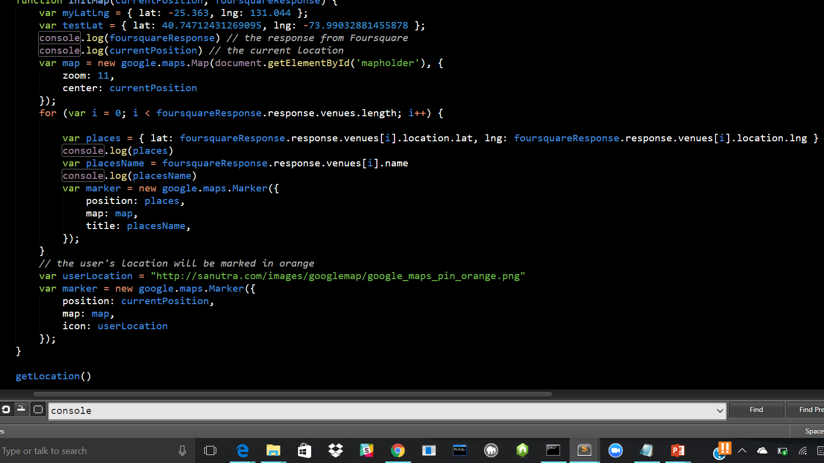
Challenges
Combine two APIs to display theaters on a custom Google map
Debugging

Slide 7
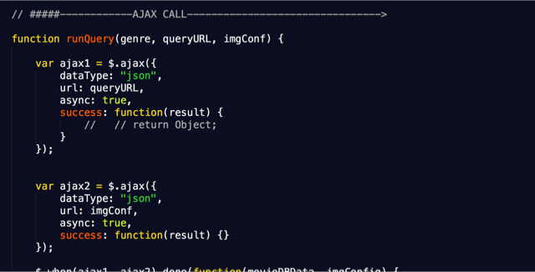
Challenges
Struggled with making the ajax requests work effectively.
Merging the teams code into Git hub.
Adding login / sign up capability using firebase.

Slide 8
Coming soon…
The next updates will include:
Option to buy movie tickets directly from the app
Directions to the movie theater from user’s location.
Schedule an Uber to the theater .
Google/ Facebook authentication to let users log in.

Slide 9
trailer ZONE
https://jimelj.github.io/Trailer-Zone/

Slide 10
Written , Produced and Directed by :
Esther Maxi
Jimel Joseph
Atul Singla

